Slide 1
http://www.vidyanidhi.com/
ketkiacharya.net@gmail.com
Ketki Acharya
From: SM VITA ATC of CDAC
ketkiacharya.net@gmail.com

Slide 2
Controller Action Return Types in ASP.NET Core Web API
Primitive or Complex Types: Actions can return primitive types (like int, string, etc.) or complex types (such as custom objects). When returning these directly, ASP.NET Core serializes the object into JSON (by default) and sets the content type of the response to application/json.
IActionResult: The IActionResult return type can return various HTTP responses, including status codes, files, and error messages. This return type is useful when an action needs to return different types of responses, such as NotFound(), OK(), BadRequest(), etc.
ActionResult<T>: The ActionResult<T> return type allows for returning either a response that can be serialized into JSON (or another format) or an action result (like IActionResult). This provides more flexibility in return types, allowing for both the return of data (as type T) and action results like NotFound() or Ok().
Specific Result Types: ASP.NET Core provides several specific result types that implement the IActionResult interface and are used to return specific types of responses. Examples include Ok, BadRequest, NotFound, and File. These result types offer a clearer intention of the HTTP response returned from the API.
Void: Returning void from an action method results in an empty 204 No Content response. This is typically used when an action performs an operation that does not need to return data to the client.
Task<IActionResult> or Task<ActionResult<T>>: For asynchronous operations, actions can return Task<IActionResult> or Task<ActionResult<T>>. This enables the action methods to perform asynchronous operations, like database calls or web service requests, without blocking the calling thread. The framework handles the task completion and writes the result to the response.

Slide 3
[HttpGet("All")]
public List<Employee> GetAllEmployee()
{
return new List<Employee>()
{
new Employee(){ Id = 1001, Name = "Anurag", Age = 28, City = "Mumbai", Gender = "Male", Department = "IT" },
new Employee(){ Id = 1002, Name = "Pranaya", Age = 28, City = "Delhi", Gender = "Male", Department = "IT" },
new Employee(){ Id = 1003, Name = "Priyanka", Age = 27, City = "BBSR", Gender = "Female", Department = "HR"},
};
}
HttpGet("Name")]
public string GetName()
{
return "Return from GetName";
}
[HttpGet("Details")]
public Employee GetEmployeeDetails()
{
return new Employee() {
Id = 1001,
Name = "Anurag",
Age = 28,
City = "Mumbai",
Gender = "Male",
Department = "IT"
};
}
[HttpGet("All")]
public IEnumerable<Employee> GetAllEmployee()
{
return new List<Employee>() {
new Employee(){ Id = 1001, Name = "Anurag", Age = 28, City = "Mumbai", Gender = "Male", Department = "IT" },
new Employee(){ Id = 1002, Name = "Pranaya", Age = 28, City = "Delhi", Gender = "Male", Department = "IT" },
new Employee(){ Id = 1003, Name = "Priyanka", Age = 27, City = "BBSR", Gender = "Female", Department = "HR"},
};
}

Slide 4
Example to Understand IActionResult Return Type in ASP.NET Core Web API:
We want to return a list of employees from our action method. If at least one Employee is present, we need to return the status OK with the list of employees. If no Employee is found, then we need to return the status code Not Found. We can achieve this very easily by using the IActionResult result type. So, modify the Employee Controller as shown below. Here, we created one action method, i.e., GetAllEmployees, with the return type IActionResult.
public IActionResult GetAllEmployee()
{
//In Real-Time, you will get the data from the database
//Here, we have hardcoded the data
var listEmployees = new List<Employee>() {
new Employee(){ Id = 1001, Name = "Anurag", Age = 28, City = "Mumbai", Gender = "Male", Department = "IT" },
new Employee(){ Id = 1002, Name = "Pranaya", Age = 28, City = "Delhi", Gender = "Male", Department = "IT" },
new Employee(){ Id = 1003, Name = "Priyanka", Age = 27, City = "BBSR", Gender = "Female", Department = "HR"},
};
//If at least of Emplpyee is Present return OK status code and the list of employees
if (listEmployees.Any())
{ return Ok(listEmployees);
}
else
{
//If no Employee is Present return Not Found Status Code
return NotFound();
}
}

Slide 5
Benefits of using IActionResult type in ASP.NET Core Web API
The IActionResult type in ASP.NET Core Web API provides several benefits that enhance web application development, maintenance, and scalability. It is a flexible and unified way to return different types of responses from controller actions. Here are some of the key benefits:
Flexibility in Response Types: IActionResult allows an action method to return various response types, such as OK, BadRequest, NotFound, or File. This flexibility lets developers easily handle responses to the needs of different API calls without having to change the method signature.
Improved Readability and Maintainability: By using IActionResult, the intent of the code becomes clearer. For instance, returning Ok(result) or NotFound() directly from an action method makes it easy to understand the possible outcomes of the API call, improving the maintainability of the code.
Support for Asynchronous Operations: ASP.NET Core supports asynchronous action methods, allowing for non-blocking I/O operations. IActionResult can be used with asynchronous patterns, such as Task<IActionResult>, to improve the scalability and performance of web applications by efficiently handling web requests.
Enhanced Client-Side Interaction: By using standardized responses provided by IActionResult, such as status codes and content results, client-side applications can more easily interpret and react to the API responses. This standardization helps in building robust client-server communication

Slide 6
Drawback of using the IActionResult type in ASP.NET Core Web API
Using IActionResult also comes with certain drawbacks, which are important to consider in the design and implementation of your API:
Lack of Strong Typing: When a controller action returns IActionResult, the specific type of response is not explicitly defined in the method signature. This lack of strong typing can make it harder for developers to understand the types of responses to expect. It can complicate the process of generating client code using tools like Swagger/OpenAPI.
Reduced Clarity and Predictability: Since IActionResult can represent a wide range of HTTP responses, it might not be immediately clear to consumers of your API what the possible responses are without consulting documentation or inspecting the implementation. This can reduce the clarity and predictability of the API, making it more difficult to use.
Performance Overhead: While often minimal, a slight performance overhead is associated with the abstraction layer IActionResult introduces. Each action result needs to be executed to generate the actual HTTP response. In high-performance scenarios, this overhead, however small, could become significant.

Slide 7
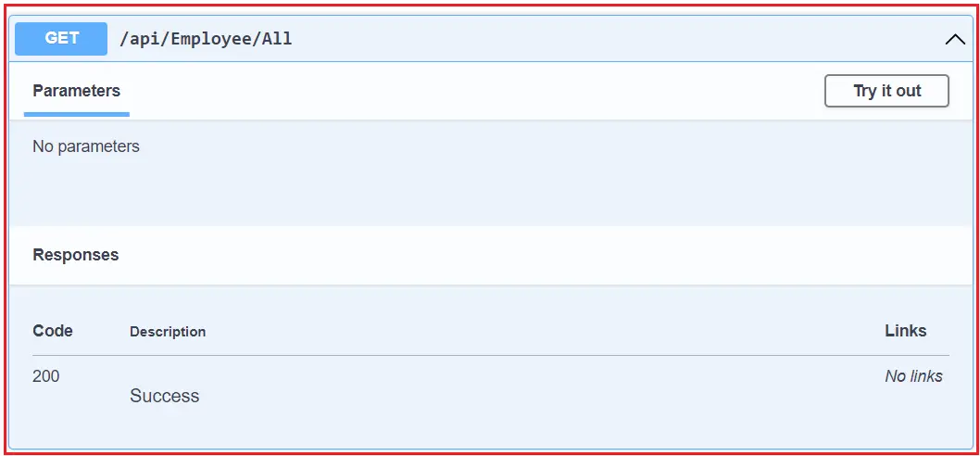
As it returns multiple data types, the swagger could not identify the output
As you can see in the above image, the kind of data the API will return is not displayed. To overcome this problem, we need to use the ProducesResponseType explicitly, as shown below.
[HttpGet("All")]
[ProducesResponseType(StatusCodes.Status200OK, Type = typeof(List<Employee>))]
[ProducesResponseType(StatusCodes.Status404NotFound)]
public IActionResult GetAllEmployee()
{
var listEmployees = new List<Employee>() {
new Employee(){ Id = 1001, Name = "Anurag", Age = 28, City = "Mumbai", Gender = "Male", Department = "IT" },
new Employee(){ Id = 1002, Name = "Pranaya", Age = 28, City = "Delhi", Gender = "Male", Department = "IT" },
new Employee(){ Id = 1003, Name = "Priyanka", Age = 27, City = "BBSR", Gender = "Female", Department = "HR"},
};
if (listEmployees.Any())
{
return Ok(listEmployees);
}
else
{
return NotFound();
}
}

Slide 8
ActionResult<T> Return Type in ASP.NET Core Web API:
ActionResult<T> extends IActionResult by allowing you to return either a response type that implements IActionResult or return a specific type T. So, it is the combination of ActionResult and Specific type. It enables us to return a type deriving either from ActionResult or a specific type.
Let us understand this with an example. Please modify the Employee Controller class as shown below. The GetEmployeeDetails method takes one parameter, and if the parameter value is 0, it returns NotFound (an ActionResult type); otherwise, it returns the employee object (a complex type).
[HttpGet("{Id}")]
public ActionResult<Employee> GetEmployeeDetails(int Id)
{
if (Id == 0) {
return NotFound();
}
else
{
return new Employee() {
Id = 1001, Name = "Anurag", Age = 28, City = "Mumbai", Gender = "Male", Department = "IT"
};
}

Slide 9
Specific Result Types in ASP.NET Core Web API
You can directly return specific result types such as OkObjectResult, BadRequestResult, NotFoundResult, etc. This approach is more explicit but less flexible than returning IActionResult or ActionResult<T>.
[HttpGet("{Id}")]
public OkObjectResult GetEmployeeDetails(int Id)
{
var item = new Employee() {
Id = Id, Name = "Anurag", Age = 28, City = "Mumbai", Gender = "Male", Department = "IT" };
return Ok(item); // Directly returns an OkObjectResult
}
Void Return Type in ASP.NET Core Web API:
Returning void from an action results in a 204 No Content response. This is suitable for actions that perform operations but don’t need to return any data.
[HttpDelete("{Id}")]
public void DeleteEmployee(int id)
{
// Returns a 204 No Content response
}

Slide 10
Task<IActionResult> or Task<ActionResult<T>> Return Type in ASP.NET Core:
For asynchronous operations, you can return Task<IActionResult> or Task<ActionResult<T>>. This allows your action methods to perform asynchronous operations and return various responses.
[HttpGet("All")]
[ProducesResponseType(StatusCodes.Status200OK, Type = typeof(List<Employee>))]
[ProducesResponseType(StatusCodes.Status404NotFound)]
public async Task<IActionResult> GetAllEmployee()
{
var listEmployees = new List<Employee>()
{
new Employee(){ Id = 1001, Name = "Anurag", Age = 28, City = "Mumbai", Gender = "Male", Department = "IT" },
new Employee(){ Id = 1002, Name = "Pranaya", Age = 28, City = "Delhi", Gender = "Male", Department = "IT" },
new Employee(){ Id = 1003, Name = "Priyanka", Age = 27, City = "BBSR", Gender = "Female", Department = "HR"},
};
if (listEmployees.Any()) {
return Ok(listEmployees);
}
else {
return NotFound();
}
}

Slide 11
Task<ActionResult<T>> Return Type in ASP.NET Core:
[HttpGet("All")]
public async Task<ActionResult<List<Employee>>> GetAllEmployee()
{
//Use async operation to get the data from the database
var listEmployees = new List<Employee>() {
new Employee(){ Id = 1001, Name = "Anurag", Age = 28, City = "Mumbai", Gender = "Male", Department = "IT" },
new Employee(){ Id = 1002, Name = "Pranaya", Age = 28, City = "Delhi", Gender = "Male", Department = "IT" },
new Employee(){ Id = 1003, Name = "Priyanka", Age = 27, City = "BBSR", Gender = "Female", Department = "HR"},
};
if (listEmployees.Any()) {
return Ok(listEmployees);
}
else {
return NotFound();
}
}

